Slide 1
Collecting Cognitive Data Online
Benjamin Katz, PhD
Virginia Tech

Slide 2
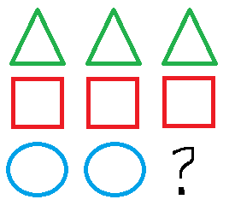
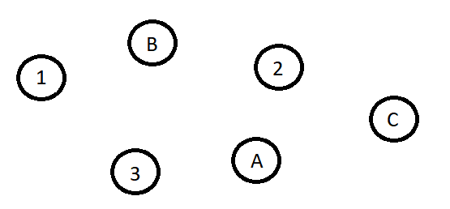
What kind of data are we talking about?

Slide 3
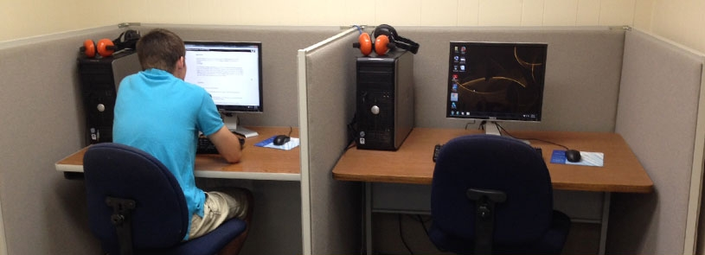
Data that is usually collected…
Pearson Vue Testing Lab, MSU Texas

Slide 4
So why collect this sort of data online?
Access to a different population…***
Larger samples
Currently the safest way to collect data!

Slide 5
Is it even possible to collect this sort of data online?

Slide 6
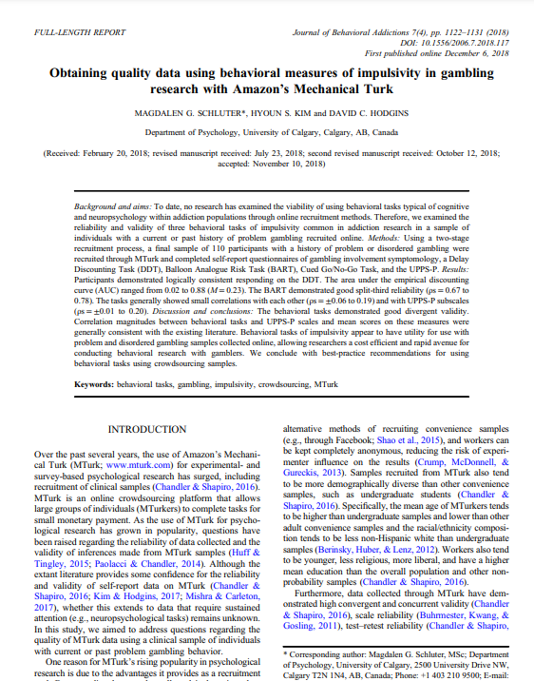
It is definitely possible… even in specialized populations!

Slide 7
Potential Issues
Quality of data
Reliability of respondents
Limitations of online survey platforms
Challenge in moving computerized assessments online/paying for programs

Slide 8
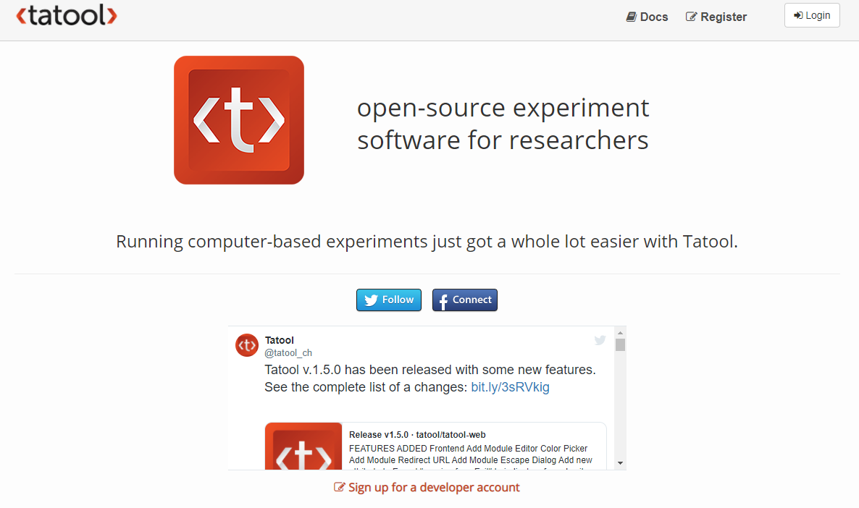
Great, free tools, especially:
Claudia von Bastian
University of Sheffield
http://www.tatool-web.com/

Slide 9
Other worthwhile tools:
PsyToolkit (https://www.psytoolkit.org/)
Finding Five (https://www.findingfive.com/)
PEBL (http://pebl.sourceforge.net/)
*While preparing this, I found an article that summarized some of these, and more, from SAGE Publishing: https://ocean.sagepub.com/blog/tools-and-technology/challenges-of-running-social-science-experiments-from-home-and-14-tools-to-help

Slide 10
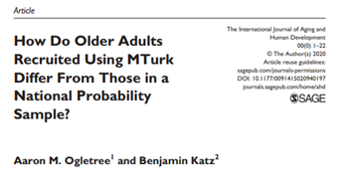
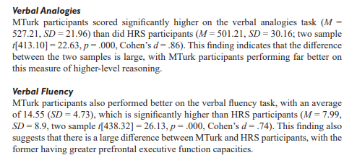
But there is plenty to be careful about
Can you really replicate an in-person experience online?

Slide 11
Best Practices, Regardless of Which Tools You Use
Think carefully about the sample and the platform (Mturk? Qualtrics Panels? Other places?)
Remember that experience with computers may be a very significant factor for participants
You would probably be surprised what you can do through standard survey programs like Qualtrics – do you even need another program?
You can’t test things enough
If possible, run participants in both the lab and online

Slide 12
Feel free to get in touch!
katzben@vt.edu

